Slide 1
Solving simple linear equations with an additive step
Task A: Additive steps using representations
1) Find the value of the unknown in each bar model. Explain how you know.
a)
15
c)
c
a
9
27
31
b)
b
33
d)
8.4
41
d
5.7
2) Complete the balance scales to show the additive step needed to find the solution. What is the solution for each equation?
a)
b)
c)
19
8
x
2
7
x
11
30
x
−2
−2
__
x
2
7
x
11
30
x
x

Slide 2
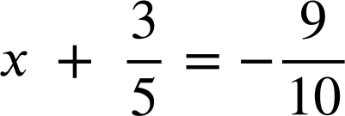
Solving simple linear equations with an additive step
Task B: Writing solutions algebraically
Solve the following equations.
a)
d)
x + 1 | = | 12
x + 13 | = | 11
b)
e)
x + 3.6 | = | 17.8
x − 10 | = | −8.4
c)
f)
x − 18 | = | 42
2) Spot the mistakes in the following methods to solve these equations.
a)
c)
x + 7 | = | −3
x + 7 + (7) | = | −3 + (7)
x | = | 4
x − 5 | = | 10
x − 5 + 10 | = | 10 + 10
x + 5 | = | 20
b)
d)
x + 7.1 | = | 23.5
x + 7.1 + (−7.1) | = | 23.5
x | = | 23.5
x − 23 | = | 23
x − 23 + 23 | = | 23 − 23
x | = | 0
Mathematics in Education and Industry
v2.3

